Slide 1
PROJECTIONS OF STRAIGHT LINES.
INFORMATION REGARDING A LINE means
IT’S LENGTH,
POSITION OF IT’S ENDS WITH HP & VP
IT’S INCLINATIONS WITH HP & VP WILL BE GIVEN.
AIM:- TO DRAW IT’S PROJECTIONS - MEANS FV & TV.
SIMPLE CASES OF THE LINE
A VERTICAL LINE ( LINE PERPENDICULAR TO HP & // TO VP)
A VERTICAL LINE ( LINE PERPENDICULAR TO VP & // TO HP)
LINE PARALLEL TO BOTH HP & VP.
LINE INCLINED TO HP & PARALLEL TO VP.
LINE INCLINED TO VP & PARALLEL TO HP.
STUDY ILLUSTRATIONS GIVEN ON NEXT PAGE
SHOWING CLEARLY THE NATURE OF FV & TV
OF LINES LISTED ABOVE AND NOTE RESULTS.

Slide 2
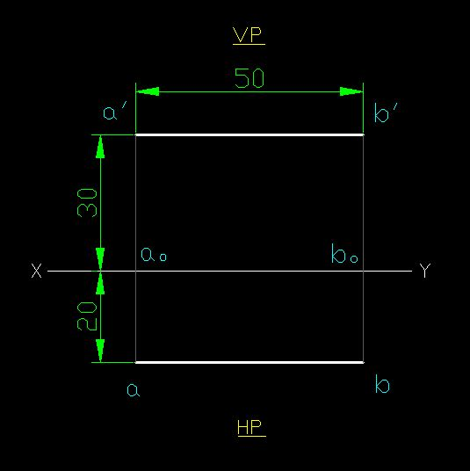

1.
A Line // to HP & // to VP.
Q: A line AB = 50 mm long. Endpoints A & B are 30 mm above HP & 20 mm in front of VP. Draw Projections.
ANSWER
(Pictorial Presentation)
Note:
Fv & Tv both are
// to xy
&
both show T. L.
For Tv
V.P.
b’
F.V.
B
a’
A
Y
For Fv
b
X
T.V.
a

Slide 3
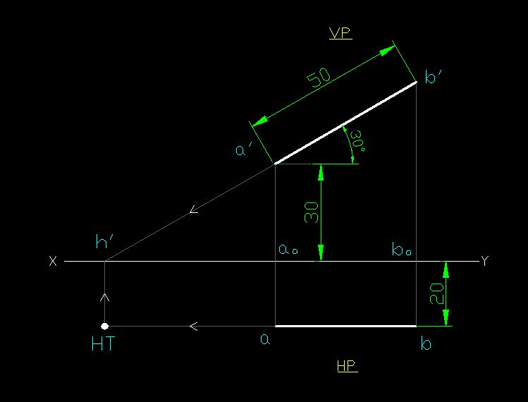
2.
A Line inclined to HP and parallel to VP.
Q: A line AB = 50 mm long is inclined to HP at 30 degree. Endpoints A & B are 20 mm in front of VP. Endpoint A is 30 mm above HP. Draw projections. And also draw trace of the line.
ANSWER
(Pictorial Presentation)
Fv inclined to xy
Tv parallel to xy.
V.P.
b’
F.V.
B
θ
Y
a’
θ
A
b
X
T.V.
a

Slide 4
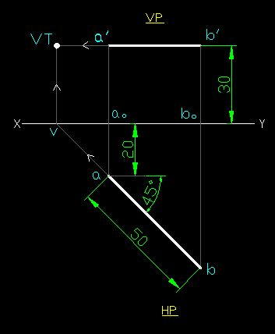
3.
A Line inclined to VP and parallel to HP
Q: A line AB = 50 mm long is inclined to VP at 45 degree. The endpoints A & B are 30 mm above HP. Endpoint
A is 20 mm in front of VP. Draw projections. Also locate the trace of the line.
ANSWER
(Pictorial Presentation)
Tv inclined to xy
Fv parallel to xy.
V.P.
F.V.
b’
a’
A
Ø
B
a
Ø
b
T.V.

Slide 5
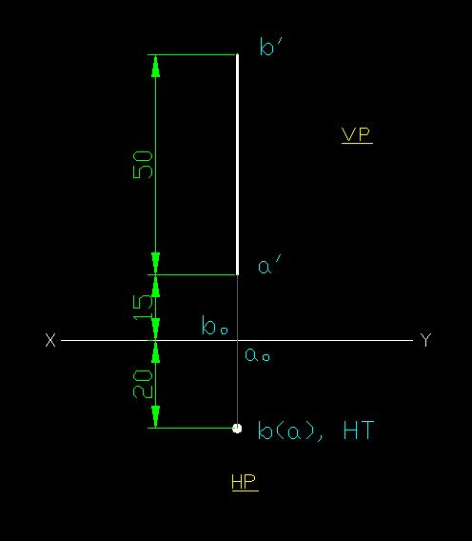
4.
A Line perpendicular to HP & // to VP
Q: A line AB = 50 mm long is perpendicular to HP. The end points A & B are 20 mm in front of VP. Endpoint A is 15 mm above HP. Draw Projections & also locate the trace of the line.
(Pictorial Presentation)
ANSWER
Note:
Fv is a vertical line
Showing True Length
&
Tv is a point.
For Tv
b’
V.P.
B
FV
a’
Y
A
For Fv
TV
b(a)
X

Slide 6
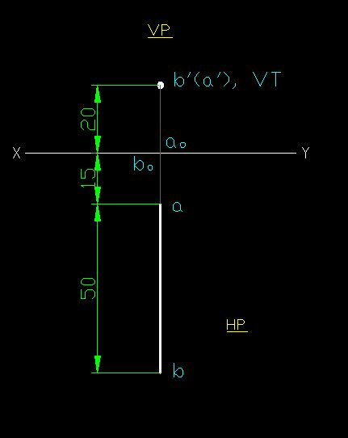
5.
A Line perpendicular to VP & // to HP
Q: A line AB = 50 mm long is perpendicular to VP. The end points A & B are 20 mm above HP. Endpoint A is 15 mm in front of VP. Draw Projections & also locate the trace of the line.

Slide 7
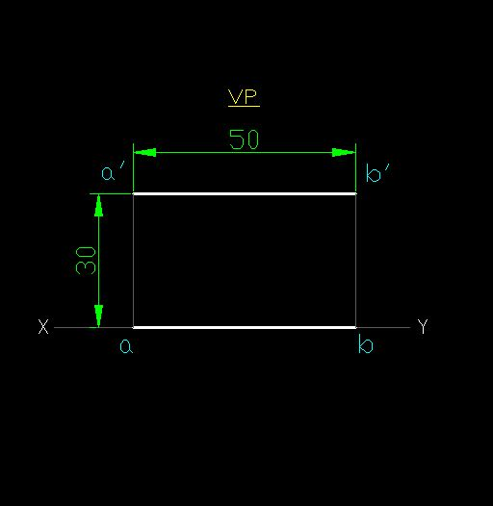
6.
A Line in VP
Q: A line AB = 50 mm long is in VP. The end points A & B are 30 mm above HP. Draw Projections.

Slide 8
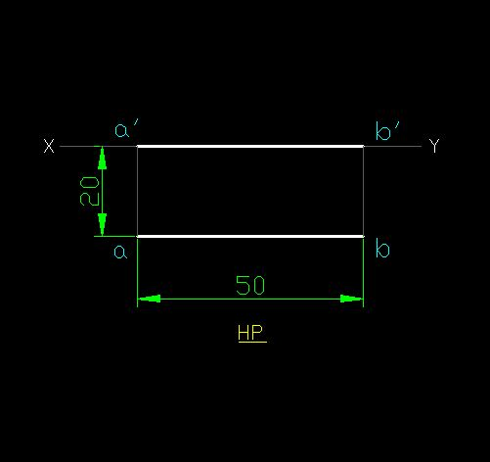
7.
A Line in HP
Q: A line AB = 50 mm long is in HP. The end points A & B are 20 mm in front of VP. Draw Projections.

